Slide 1
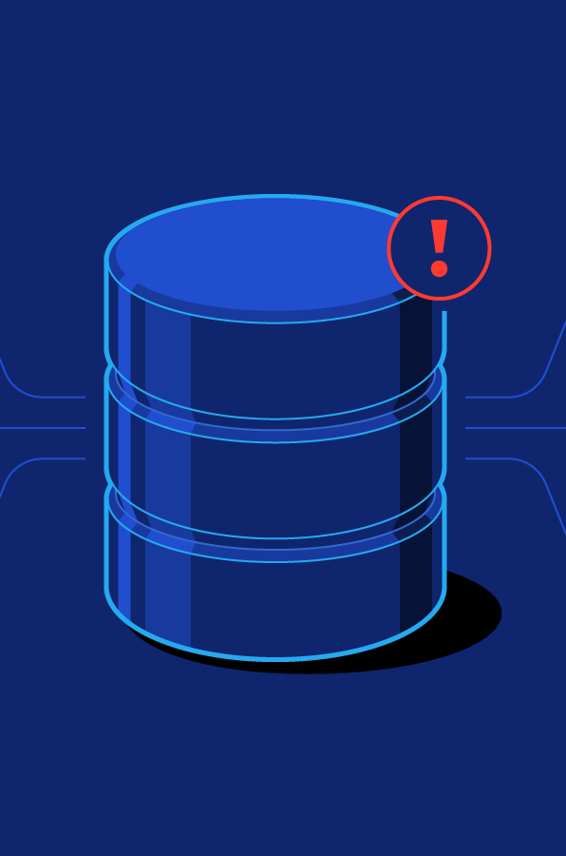

GROUP 1:
Dương Đăng Hưng BI10-073
Tạ Quang Hiếu BI10-065
Đỗ Quang Hiếu BI10-063
Nguyễn Hoàng Minh BI10-112
Đỗ Hoàng Quân BI10-147

Slide 2


Slide 3


Slide 4


Slide 5
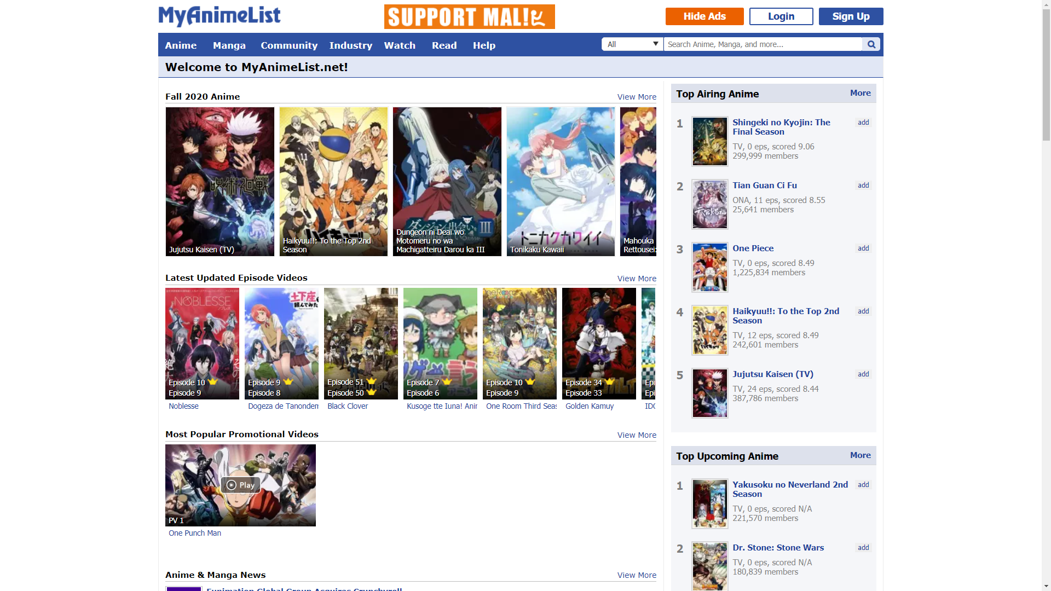

Slide 6
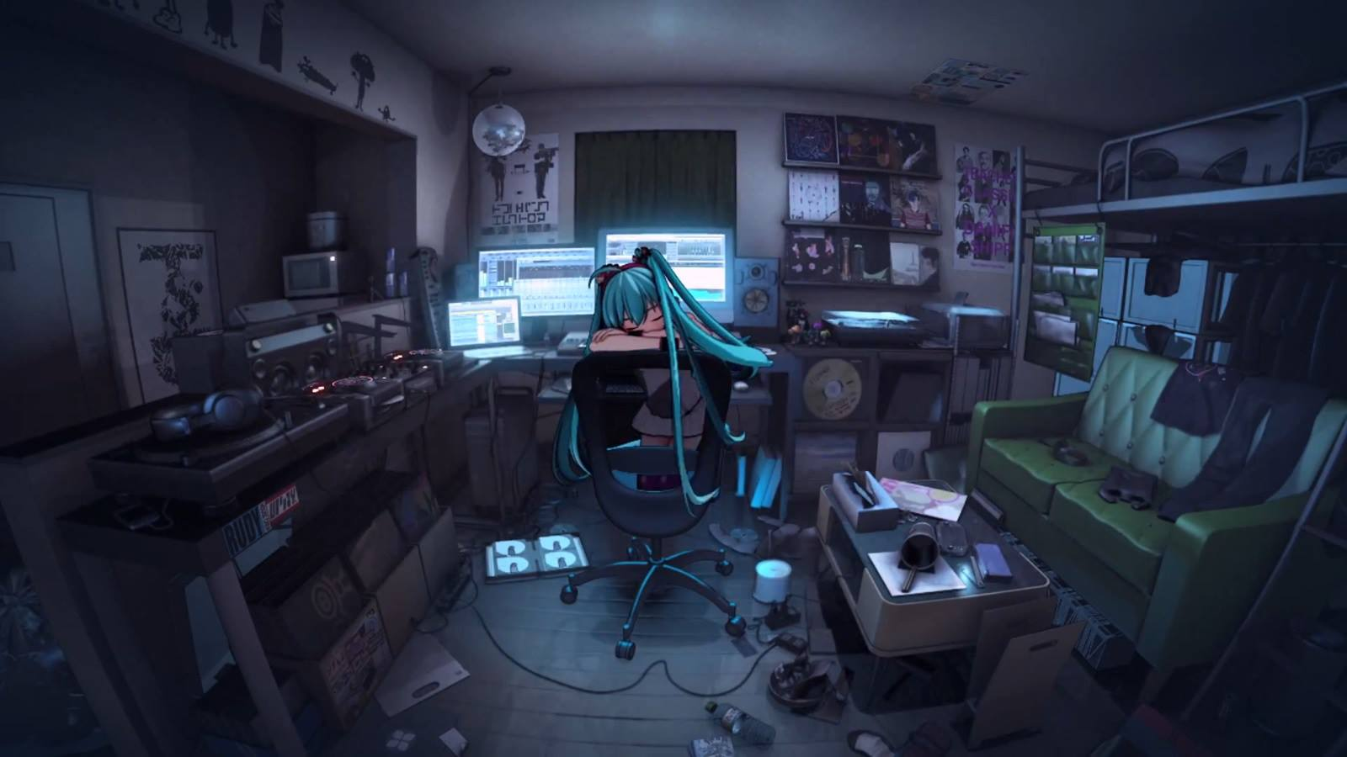
Anime Website Management

Slide 7
User requirements
Entity Relationship Diagram (ERD)
Anime Website Management
Database Schema
Implement databases using MySQL

Slide 8
1. User requirements

Slide 9


Users
Website managers/Admins
Watchers/Viewers

Slide 10
Different types of users
Different purposes
Different requirements
Different functionalities

Slide 11
1.1. Website manager
Manage an anime’s information: upload, view, edit, delete
Upload an anime’s new episode
Delete an existed episode
Create, update, provide watchers with lists such as “Top trending anime”
Check the number of views of an anime
Manage watchers’ comment: view, edit, delete

Slide 12
1.2. Watcher
Register a new account
Edit account’s information: name, gender, email address, date of birth
Record account’s watch history
Delete account
Write, edit, delete comments
Mark an anime as “favorite” or as “plan-to-watch”
View his/her own account profile or other watchers’ account profile
Use the search filter to: find an anime based on its title or character; filter animes with specific genres or studio; sort anime by views

Slide 13
2. Entity Relationship Diagram

Slide 14
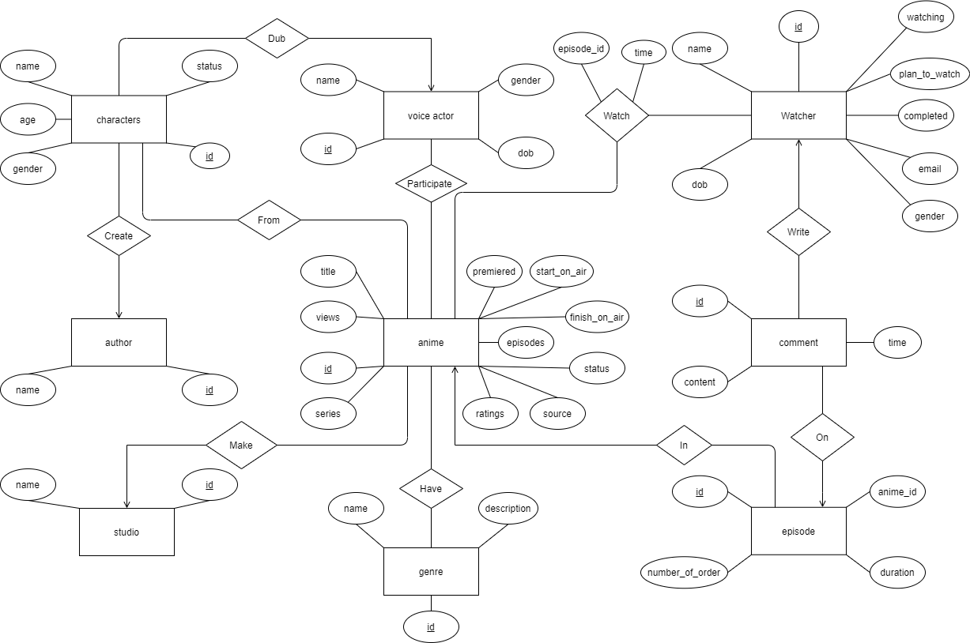

Slide 15
3. Database schema

Slide 16
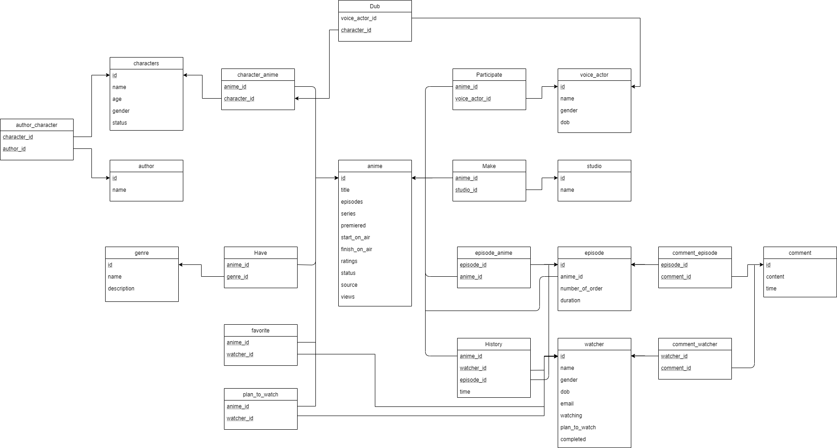

Slide 17
Further explanations for the schema are in the report!!

Slide 18
4. Implement databases using mySQL

Slide 19
21 relations (entity sets + relationships + …)
Each block of codes ≈ 7-8 lines (or more)
In part 4.3 and 4.4, we mostly use stored procedure, which make the codes even longer
→ Only the most fundamental and typical ones are presented. More details are in SQL files

Slide 20
4.1. Create tables

Slide 21
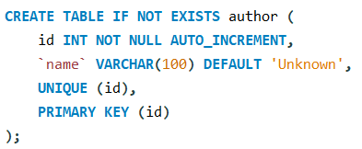
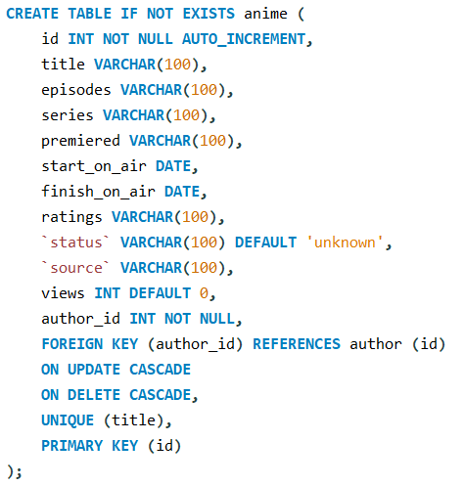
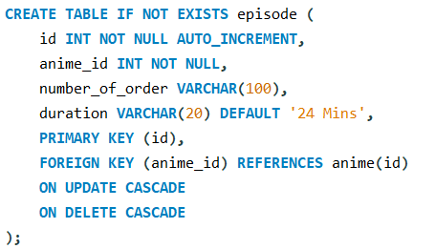
author:
anime:
episode:

Slide 22
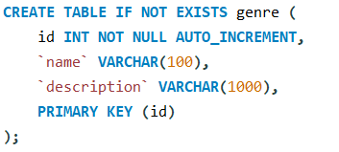
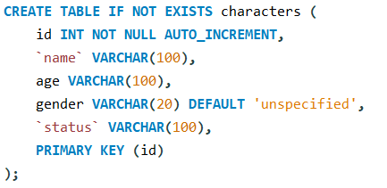
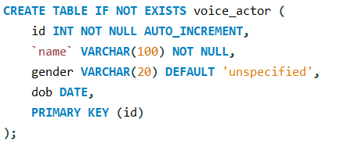
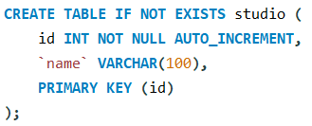
genre:
characters:
voice_actor:
studio:

Slide 23
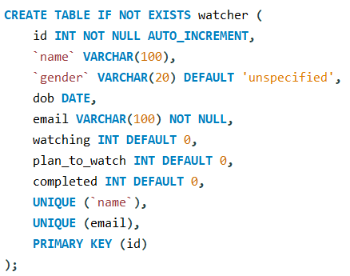
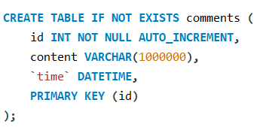
watcher:
comments:

Slide 24
In the creation of tables, we always add “ON UPDATE CASCADE” and “ON DELETE CASCADE” to every foreign key so that the situation does not get “complicated” when we want to delete or update (edit)
We also provide the creating-table codes for some relations such as “History”, “Favorite”, “plan_to_watch” in the report.
The code for those relations which represents the relationships among entity sets are in SQL files.

Slide 25
4.2. Insert sample rows

Slide 26
The codes for this part are not included in the slides (they all uses the same syntax INSERT INTO – VALUES)
Only the results are shown

Slide 27
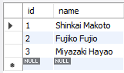



Insert sample rows for author:

Slide 28
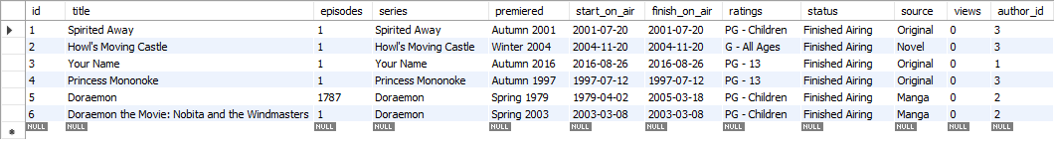
Insert sample rows for anime

Slide 29




Slide 30


Slide 31



Slide 32
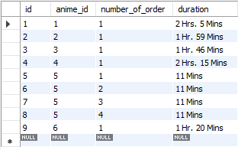
Insert sample rows for episode

Slide 33
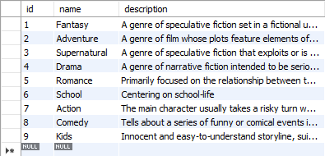
Insert sample rows for genre

Slide 34
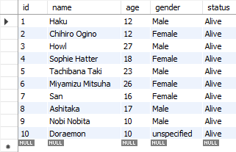
Insert sample rows for characters

Slide 35








Haku
Chihiro Ogino
Tachibana Taki
Miyamizu Mitsuha
Howl
Sophie Hatter
San
Ashitaka

Slide 36
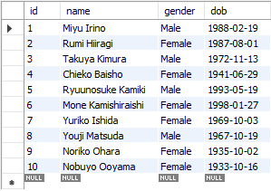
Insert sample rows for voice_actor

Slide 37
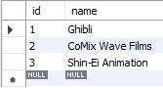
Insert sample rows for studio

Slide 38
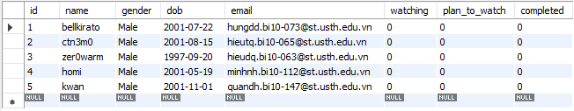
Insert sample rows for watcher

Slide 39
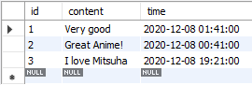
Insert sample rows for comments

Slide 40
4.3. Website managers’ requirements

Slide 41
Remind of website managers’ requirements
Manage an anime’s information: upload, view, edit, delete
Upload an anime’s new episode
Delete an existed episode
Create, update, provide watchers with lists such as “Top trending anime”
Check the number of views of an anime
Manage watchers’ comment: view, edit, delete

Slide 42
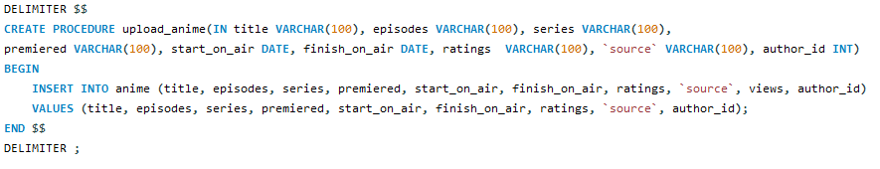
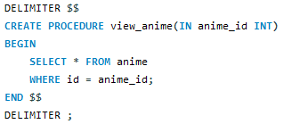
Upload a new anime:
View an anime’s information:

Slide 43
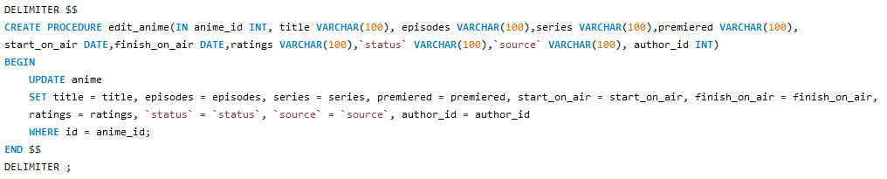
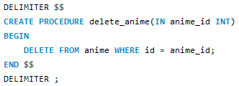
Edit an anime’s information:
Delete an anime:

Slide 44
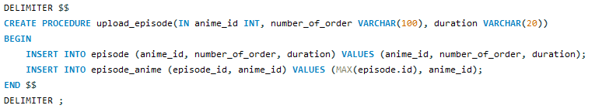
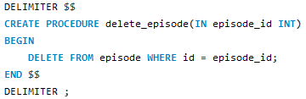
Upload an anime’s new episode:
Delete an existed episode:

Slide 45
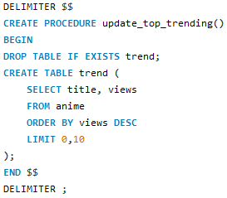
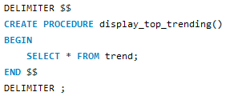
Create and update “Top trending anime” list based on views:
This is not really an update. Each time we call the procedure, it deletes the old table and create a new one
View/display “Top trending anime” list:

Slide 46
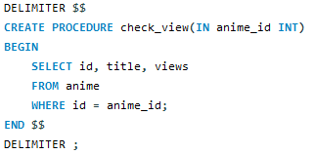
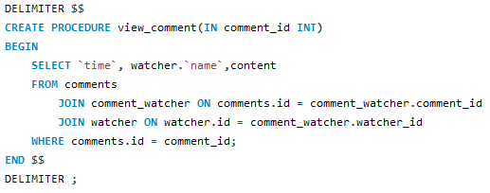
Check the number of views of an anime:
View watcher’s comment:

Slide 47
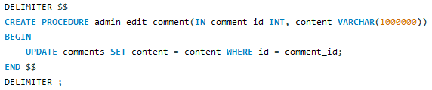
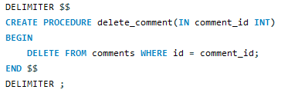
Edit watcher’s comment:
Delete watcher’s comment:

Slide 48
4.4. Watchers’ requirements

Slide 49
Remind of watchers’ requirements
Register a new account
Edit account’s information: name, gender, email address, date of birth
Record account’s watch history
Delete account
Write, edit, delete comments
Mark an anime as “favorite” or as “plan-to-watch”
View his/her own account profile or other watchers’ account profile
Use the search filter to: find an anime based on its title or character; filter animes with specific genres or studio; sort anime by views

Slide 50
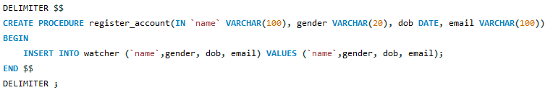
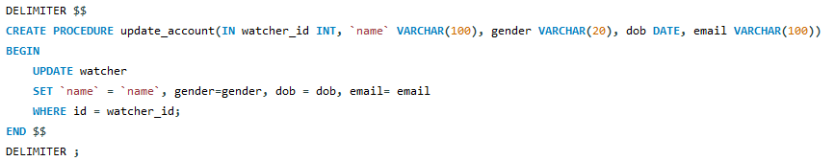
Register a new account:
Edit account’s information:

Slide 51
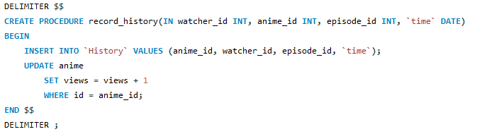
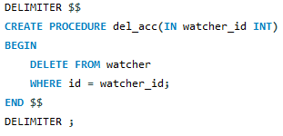
Record watch history:
Increase the views of the anime by 1 everytime a watcher watches an episode of that anime
Delete account:

Slide 52
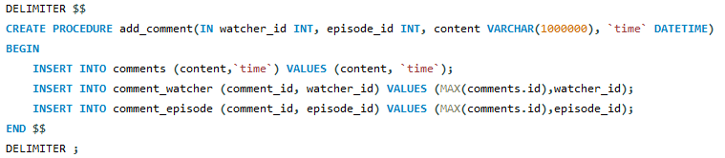
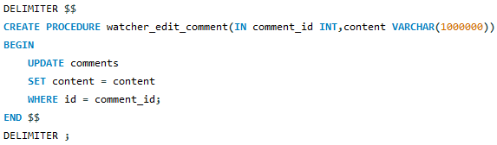
Write comment:
Edit comment:

Slide 53
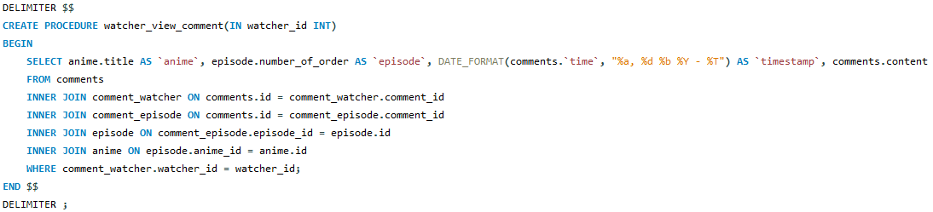
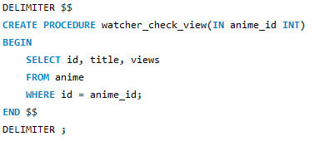
View all his/her comments:
Check the views of an anime:

Slide 54
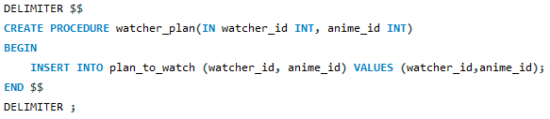
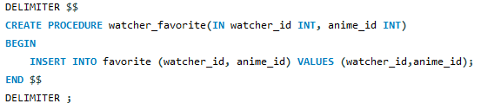
Mark an anime as plan-to-watch:
Mark an anime as favorite:

Slide 55
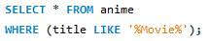
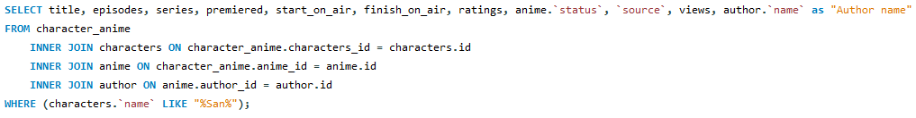
- Search an anime based on its name, for example: search for anime that has “Movie” in its name:
Search filter:
- Search an anime based on its character, for example: search for anime that has character named “San”:

Slide 56
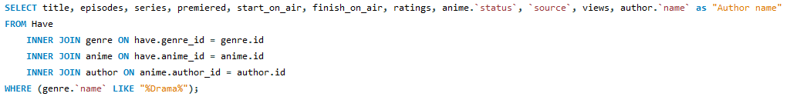
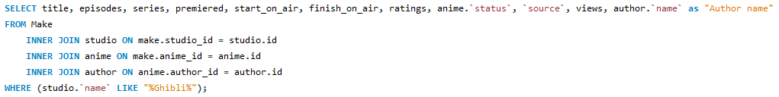
- Filter/lists anime by genre, for example: lists all animes that have the genre “Drama”:
Search filter:
- Filter/lists anime by studio, for example: lists all animes that were made by “Ghibli” studio:

Slide 57
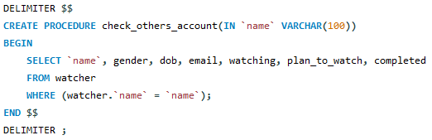
- Sort anime by views:
Search filter:
View accounts:
- View other watchers’ account profiles:

Slide 58


- View his/her own account profile:
View accounts:
- View his/her own plan-to-watch list:

Slide 59


- View his/her own watch history:
View accounts:
- View his/her own favorite animes:

Slide 60
Topic :Anime Website Management
User requirements
Entity Relationship Diagram (ERD)
Database Schema
Implement databases using MySQL

Slide 61




Q & A

Slide 62

Thank
for
you
listening!

